Slide 1
Efﬁcient 3D Reconstruction of Vessels from Multi-views of X-Ray Angiography
Xinglong Liu¹, Fei Hou¹, Shuai Li¹ , Aimin Hao¹, Hong Qin²
1.State Key Laboratory of Virtual Reality Technology and Systems, Beihang University, China houfei@vrlab.buaa.edu.cn
2.Stony Brook University, Stony Brook, USA
qin@cs.sunysb.edu
Notes:
Please enter the title and authors information in this slide but do NOT change the settings of Advance Slide for this slide.
Right before your presentation starts, this slide will be shown for exactly 10 seconds. You may start speaking as soon as you arrive at the podium, or you can wait for your first slide to appear.
Right after your presentation, there will be the title slide of the next presentation, lasting 10 seconds, during which you should leave the stage allowing the next presenter to hop on and reach the podium in time.

Slide 2
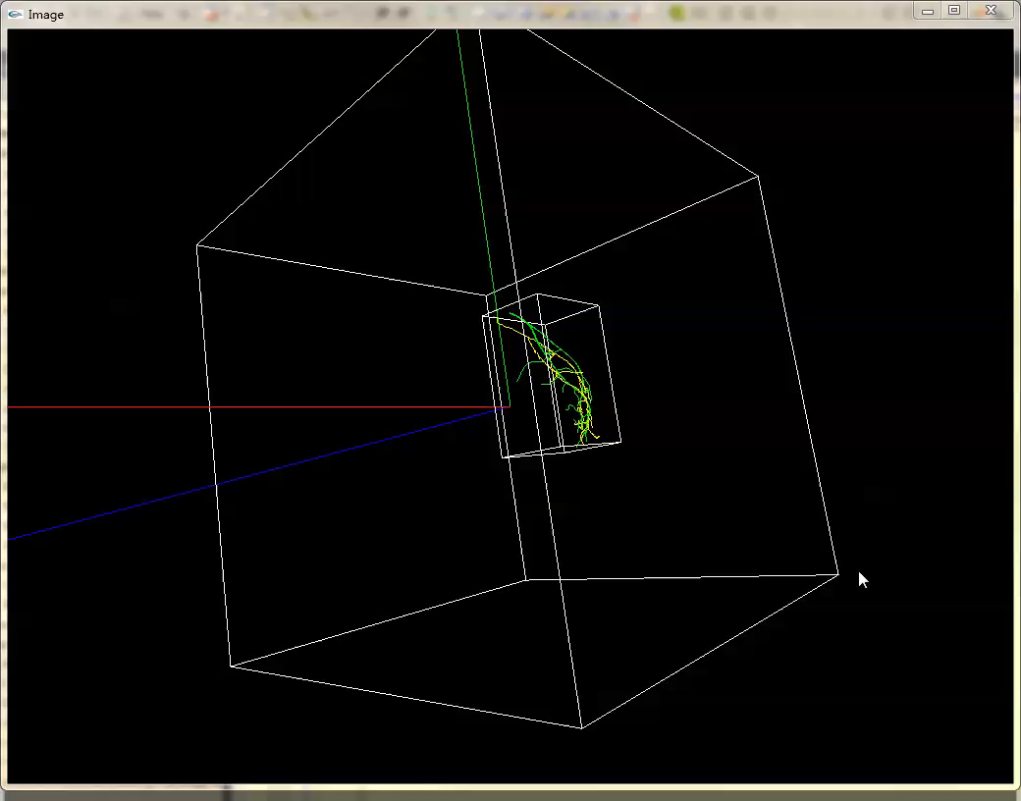
Notes:
This is the reconstructed vessel skeletons. The yellow lines indicate the
reconstructed skeleton using our method. The green lines
indicate the ground truth. The inner white box is the bounding box of the ground
truth.

Slide 3
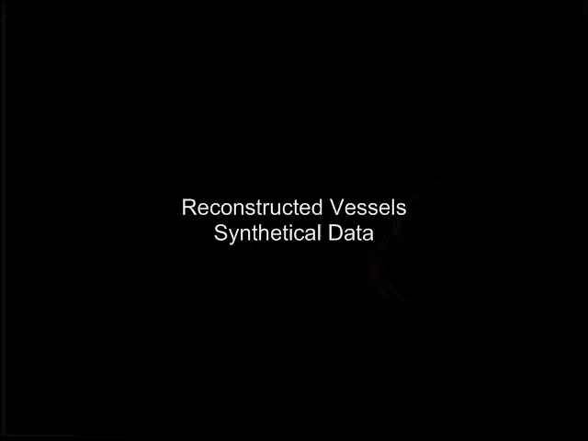
Notes:
So, this is result with the extracted vessel diameters.

Slide 4
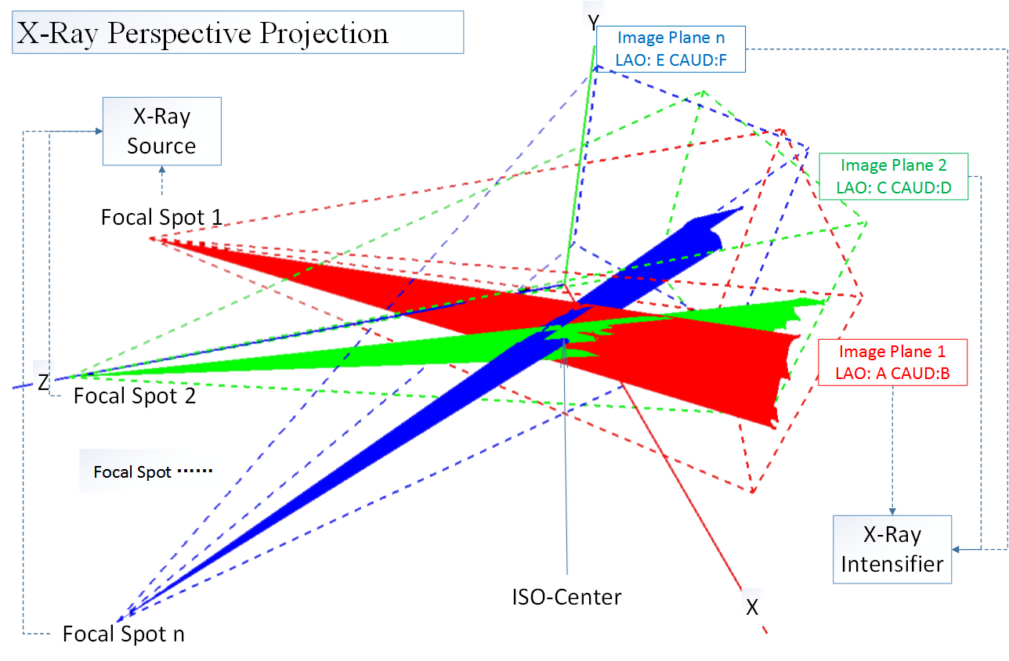
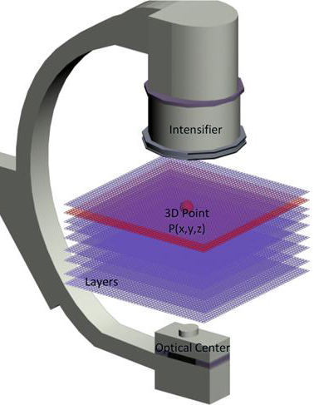
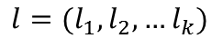
3D Reconstruction
$$l=(l_{1},l_{2},…l_{k})$$
X-Ray Perspective Projection
X-Ray Slices
Notes:
The image on the left is how we simulate the imaging procedure using OpenGL.
We use at least three views of angiograms at the same cardiac cycle and choose
one typical projection view $I_{1}$ . As the right image shows, the 3D space is divided into 3D slices.
For a given pixel $p$ on the angiograms , the pair $(p, l_{i})$ uniquely identifies a point in 3D space. So, the goal of the 3D reconstruction is
to optimally assign an label $l_{i}$ to each $p$ on the centerline of the reference view $I_{1}$ .
This problem can be formulated as an energy minimization problem considering connectivity and topological structures.
We use belief propagation to solve this problem.

Slide 5
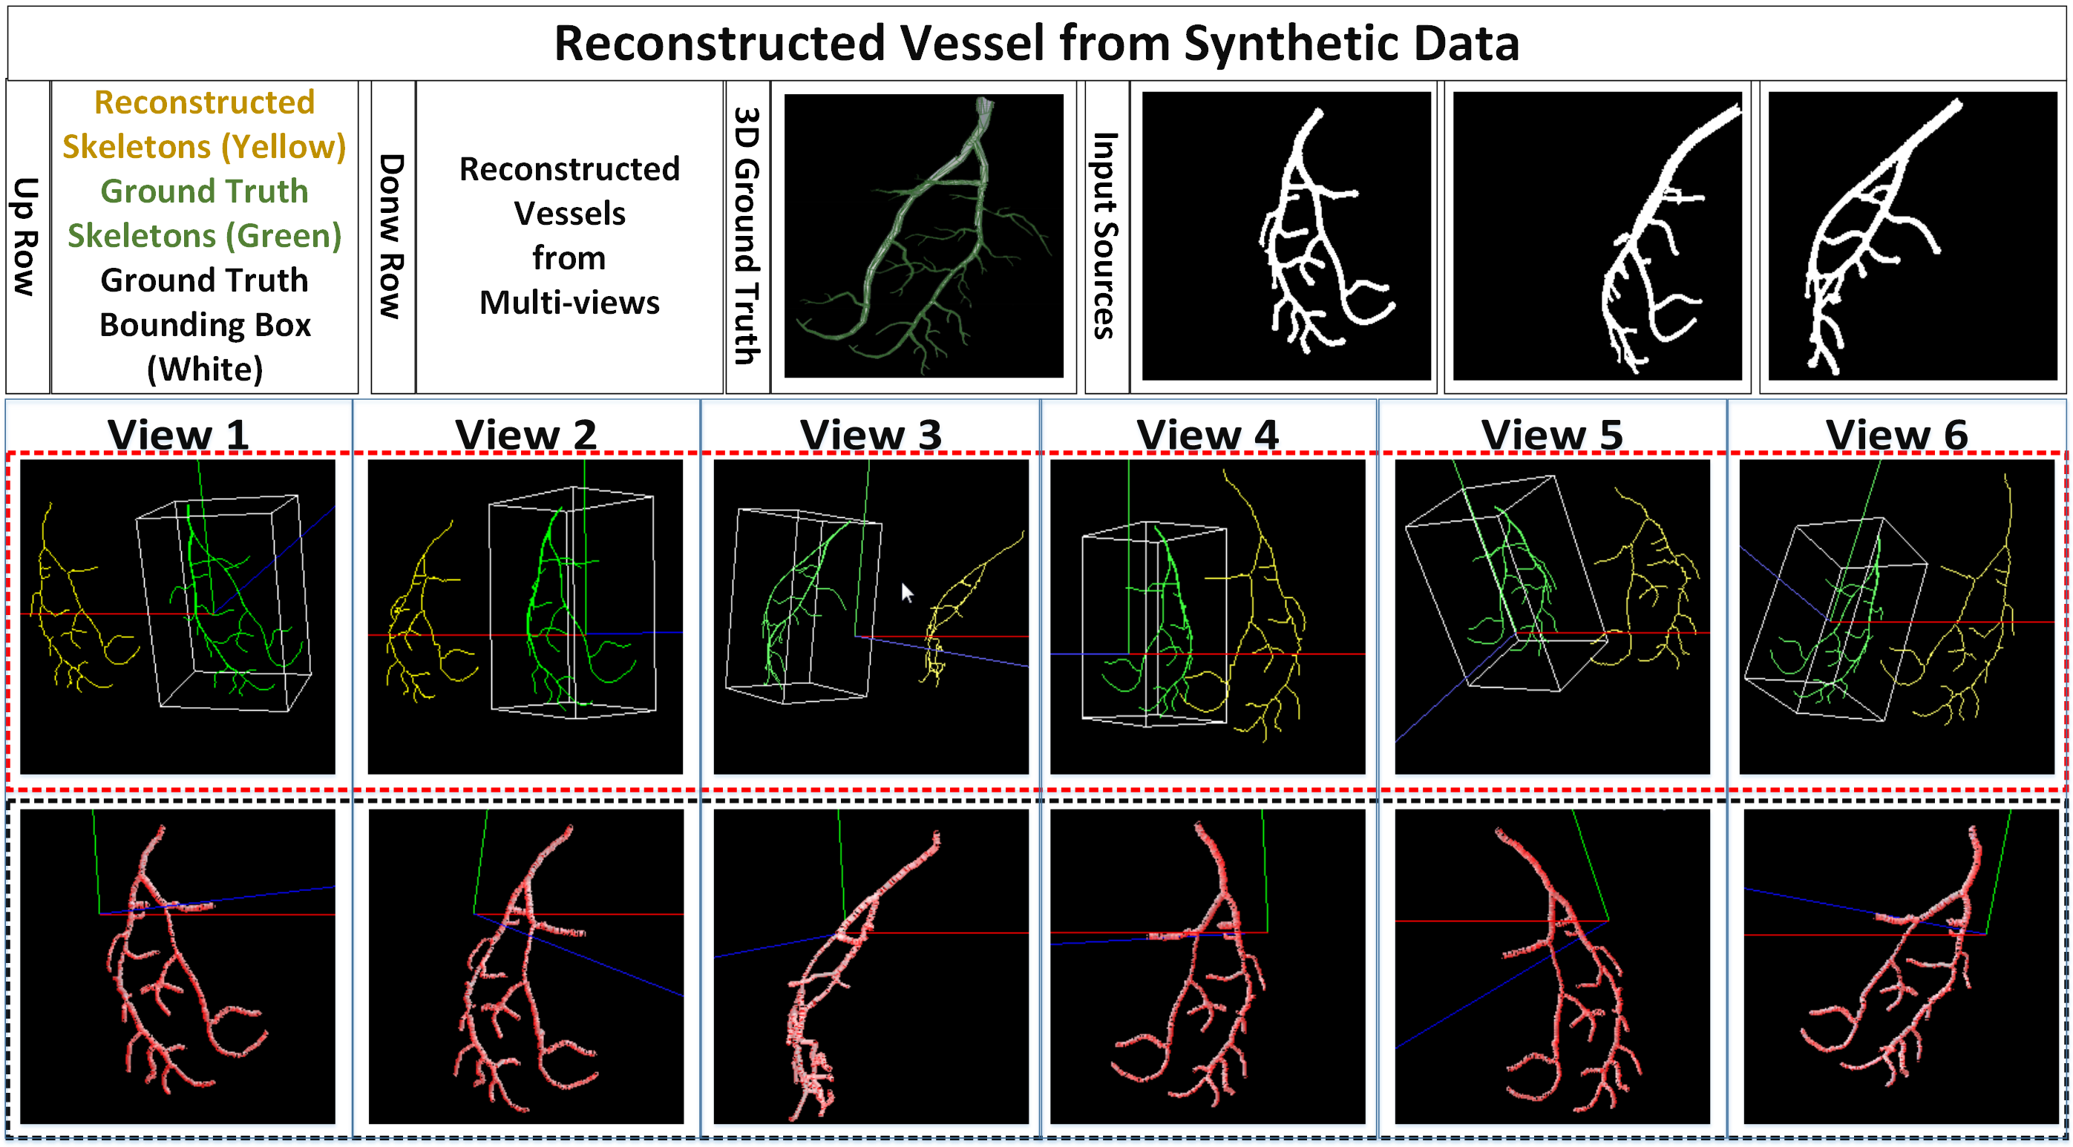
Experimental Results

Slide 6
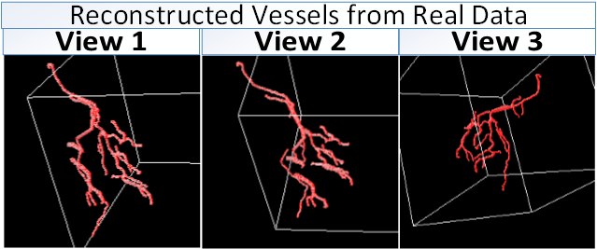
Experimental Results

Slide 7
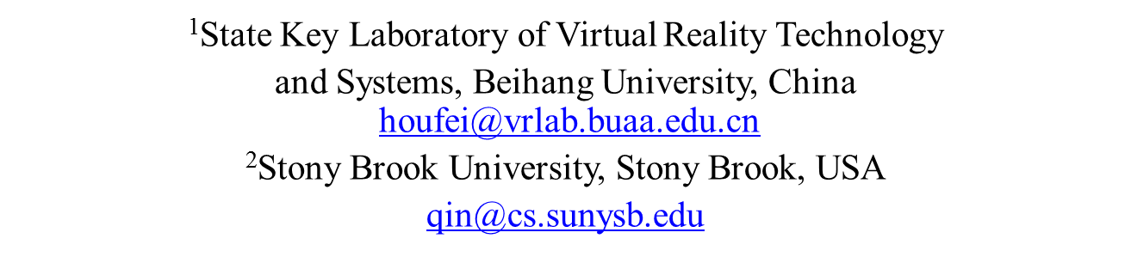
Thank You
This work is supported by National Natural Science Foundation of China (No. 61190120, 61190121, 61190125, 61300067, and 61300068) and National Science Foundation of USA (No. IIS-0949467, IIS-1047715, and IIS-1049448).
Efﬁcient 3D Reconstruction of Vessels from Multi-views of X-Ray Angiography
Xinglong Liu¹, Fei Hou¹, Shuai Li¹, Aimin Hao¹, Hong Qin²

Slide 8
Contributions
We divide the spaces between the X-Ray iso-center and the detector into slices in which we sample the 3D space points and project them to the image space considering consistency and continuity with their neighbors, overcoming the lack of constraints for typical registrations.
We formulate the 3D reconstruction as a global energy optimization problem and solve it by using belief propagation

Slide 9
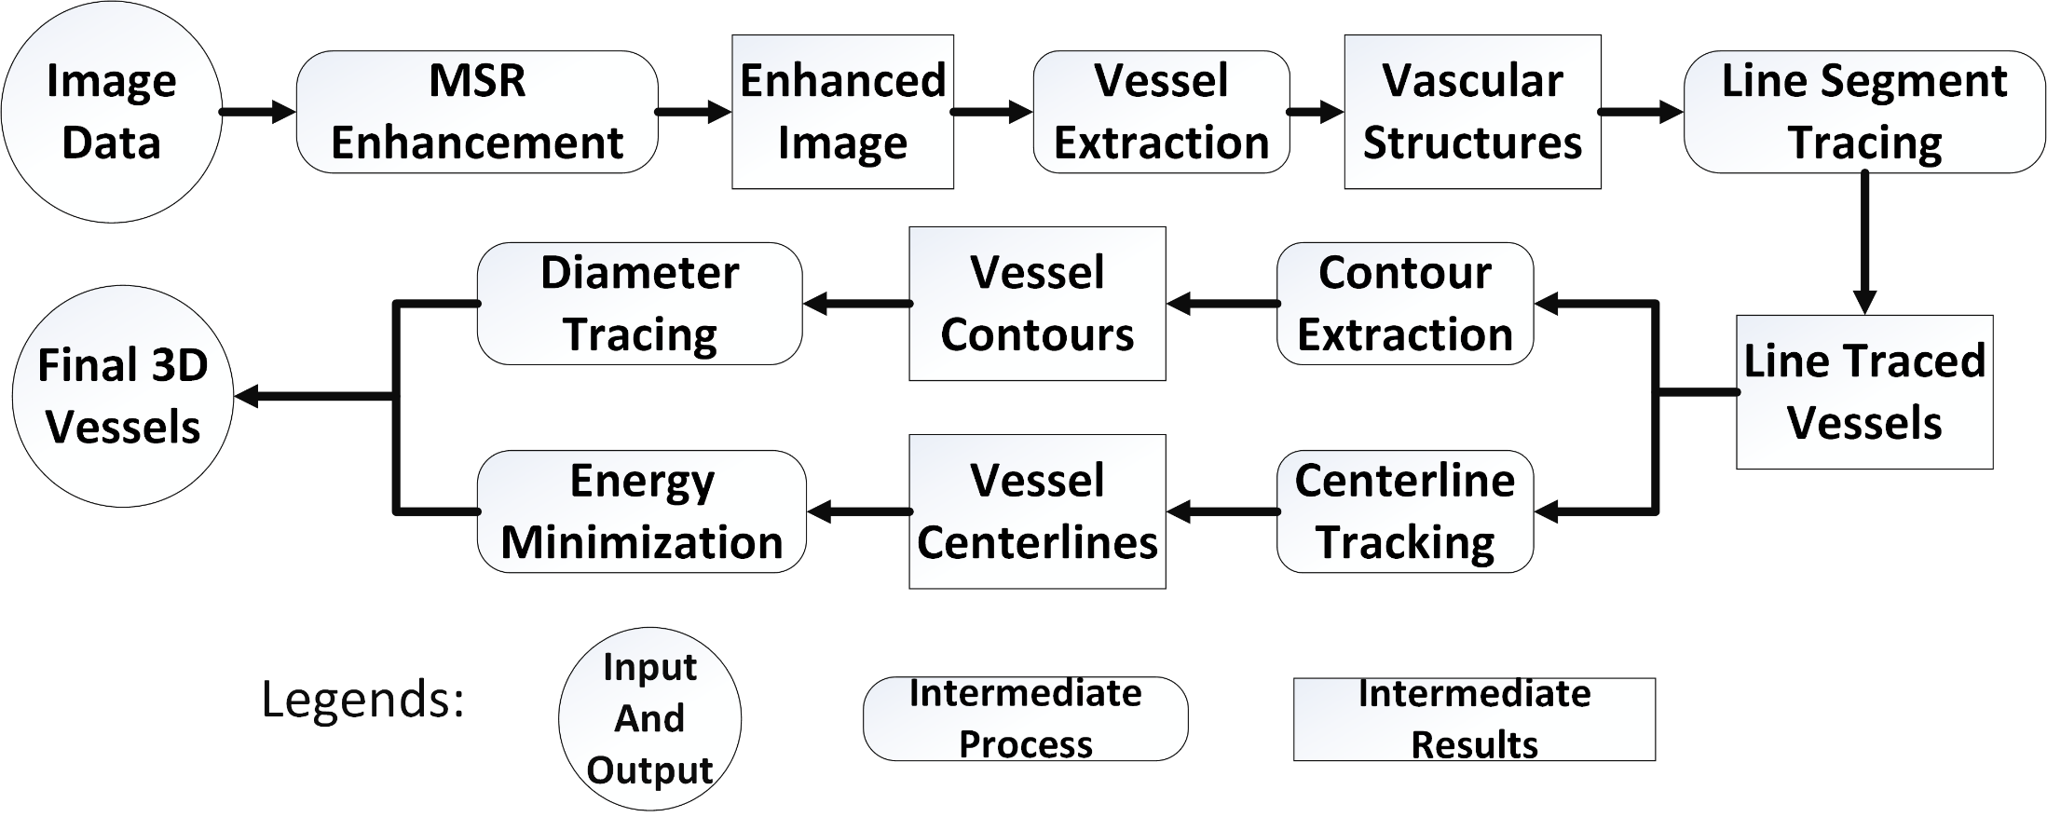
Method Overview
ROUNDED RECTANGLE
RECTANGLE
CIRCLE

